Slide 1
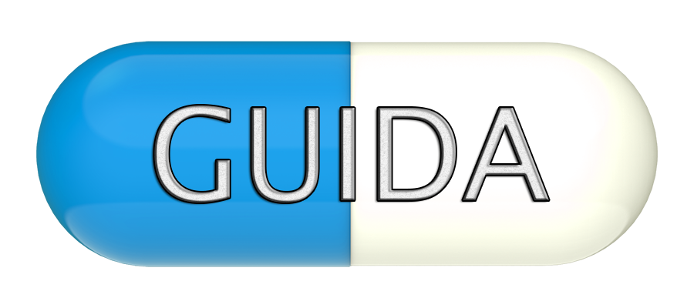

Antibiotic Drug Prescription 1
Name: Sean Iamartino
Team Member(s): Alan Nieto
Product Owner(s): Giri Narasimhan
Instructor: Masoud Sadjadi
School of Computing and Information Sciences
Florida International University
Senior Project Final Presentation
<Summer 2016>
08/03/2016
Notes:
7 seconds.
Greet your audience, thank them for attending your presentation, introduce yourself, introduce your project, introduce your team members, and quickly indicate what each of you did in a high-level manner, and put more emphasis on your part/contribution.

Slide 2
Project definition
Problem:
Antibiotic resistance is a major issue confronting healthcare providers and their patients.
Changing antibiotic resistance patterns, rising antibiotic costs and the introduction to new antibiotics have made selecting optimal antibiotic regimens more difficult now than ever before.
Create an app that:
  is user friendly
  cross-platform
  can aid a physician by suggesting the proper antibiotic to use for a specific patient.
Notes:
10 seconds.
Introduce the problem that the whole project (in all versions) tackles with GIF or screenshot.

Slide 3
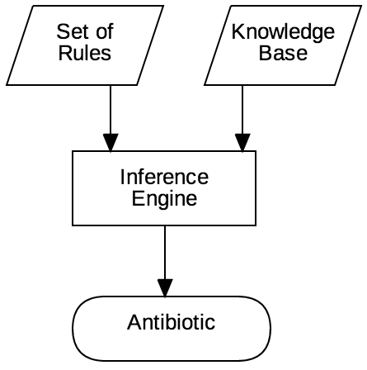
Project definition
Solution:
Rule-Based System

Slide 4
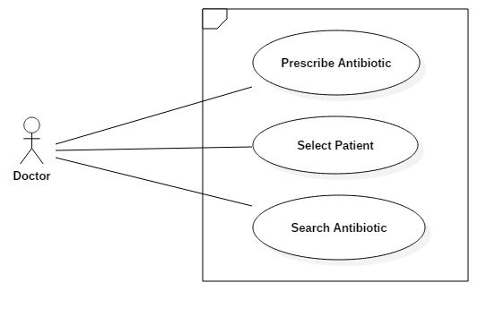
Requirements: Use Cases
Notes:
5 seconds
Show the Use Case Diagram for the whole project.
Highlight your use cases.

Slide 5
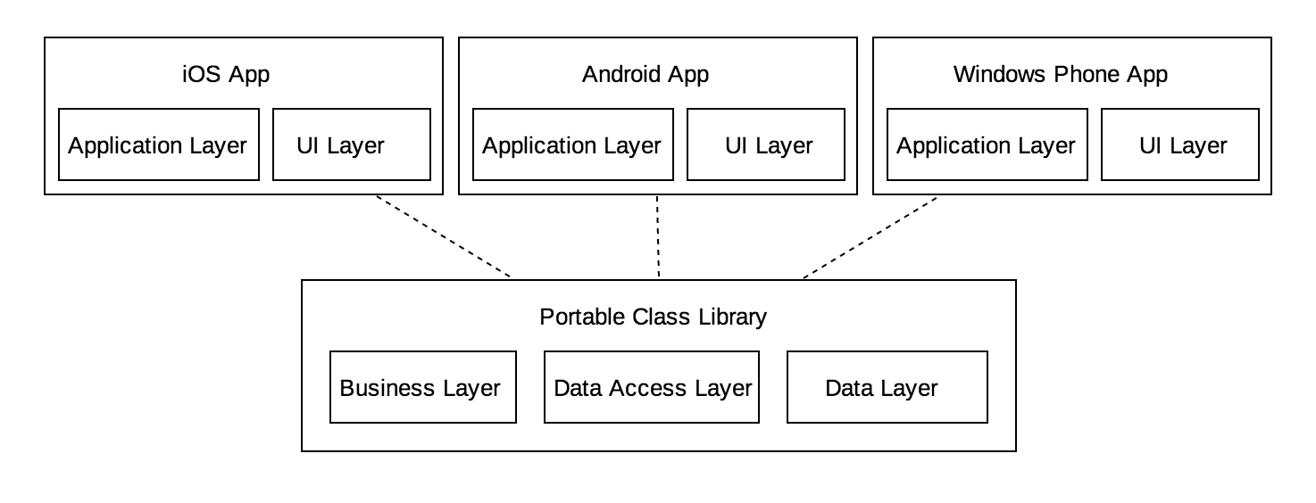
System Design: Architecture
Notes:
20 seconds
System design: Highlight the parts that you contributed to them.
1. System decomposition; identify the architecture patterns used
2. System deployment – h/w and s/w requirements

Slide 6
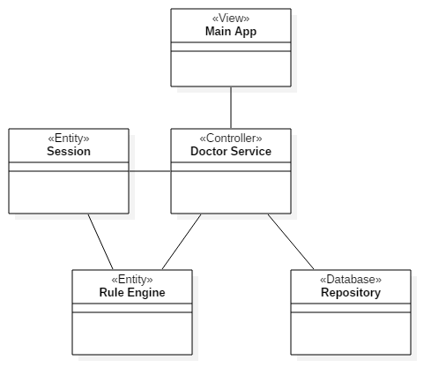
Minimal Class Diagram
Notes:
10 seconds.
Minimal class diagram. Highlight the classes that you created/modified
Identify the design patterns used (one or more slides).

Slide 7
User Stories
Implement Log in/out
Implement Antibiotic Information
Implement Inference Engine
Implement Inference Engine Graceful Failures
Improve Android UI/UX Further
Notes:
5 seconds.
List the user stories that you worked on them.(put in order of importance). Stay focused on the parts that you have been working.

Slide 8
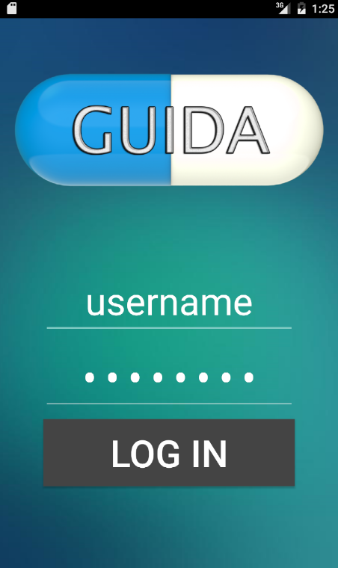
User Story #1: Implement Log in/out
Doctors must be logged in so that they can view their patients.
Patients must be accessed only by their physician.

Slide 9
User Story #2: Implement Antibiotic Information
Antibiotic information in the database
    store
    retrieve
    view
Necessary for the core features of the app to function.

Slide 10
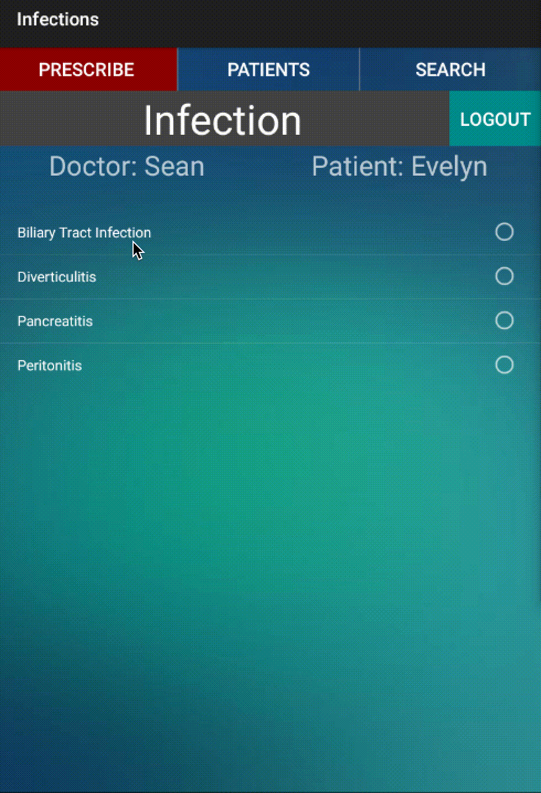
User Story #3: Implement Inference Engine
The ability to determine the proper antibiotic
  Read from the rule set
  Evaluate from the knowledge base(patient data)

Slide 11
Evaluating Rules
Rules are stored as strings in the database.
Rules take the form of:
  “variable == value && variable == value && …”
Rules are broken down using the regular expression:
\s*(\w+(\s*\w+)*)\s+([<>=]+)\s*(\w+(\s*\w+)*)
Extracting the variable, operator, and value from each sub-condition.
The variable is then used to get the patient data and compared to the value
This system allows for plain english rules such as:
ex. “Patient’s weight > 150 && PCN Allergy == Severe”

Slide 12
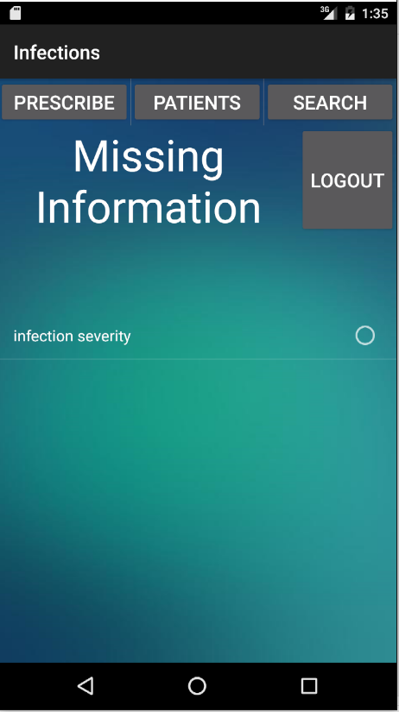
User Story #4: Implement Rule Engine Graceful Failures
Insufficient knowledge should be dealt with gracefully
  Inform user what went wrong

Slide 13
User Story #5: Improve UI/UX
Make the app
  More presentable
  Easy to use
  Visually stimulating

Slide 14
Test Suites and Test Cases
Sunny Day
Test ID: U672-TC002
Purpose: Evaluate condition returns true with a true conditional string(real application)
Preconditions: Knowledge: community acquired = true, severely ill = false, PCN allergy = no Condition: community acquired == true & severely ill == false & PCN allergy == no
Input: evaluateCondition(condition, knowledge)
Expected Result: true
Notes:
10 seconds
A description of verification process and Test Suites and Test Cases for one of the use cases.
1 One sunny day and one rainy day for the implemented use cases (one or more slides).
2 Automated test scripts for the implemented use cases (if any) (one or more slides).

Slide 15
Test Suites and Test Cases
Rainy Day
Test ID: U672-TC003
Purpose: Evaluate condition returns false with a false conditional string
Preconditions: Knowledge: community acquired = true, severely ill = false, PCN allergy = no Condition: community acquired == false & severely ill == false & PCN allergy = no
Input: evaluateCondition(condition, knowledge)
Expected Result: false
Notes:
10 seconds
A description of verification process and Test Suites and Test Cases for one of the use cases.
1 One sunny day and one rainy day for the implemented use cases (one or more slides).
2 Automated test scripts for the implemented use cases (if any) (one or more slides).

Slide 16






Summary
Summary
Contact information
  Email: siama001@fiu.edu
Questions?
Thank You!
Notes:
10 seconds
Summarize your contribution, mention your effort for Scrum, Mingle, Github, Google Drive Documentation and minutes
Include your contact information
Ask if anyone has any questions for you.
Thank your audience

